Slide 1
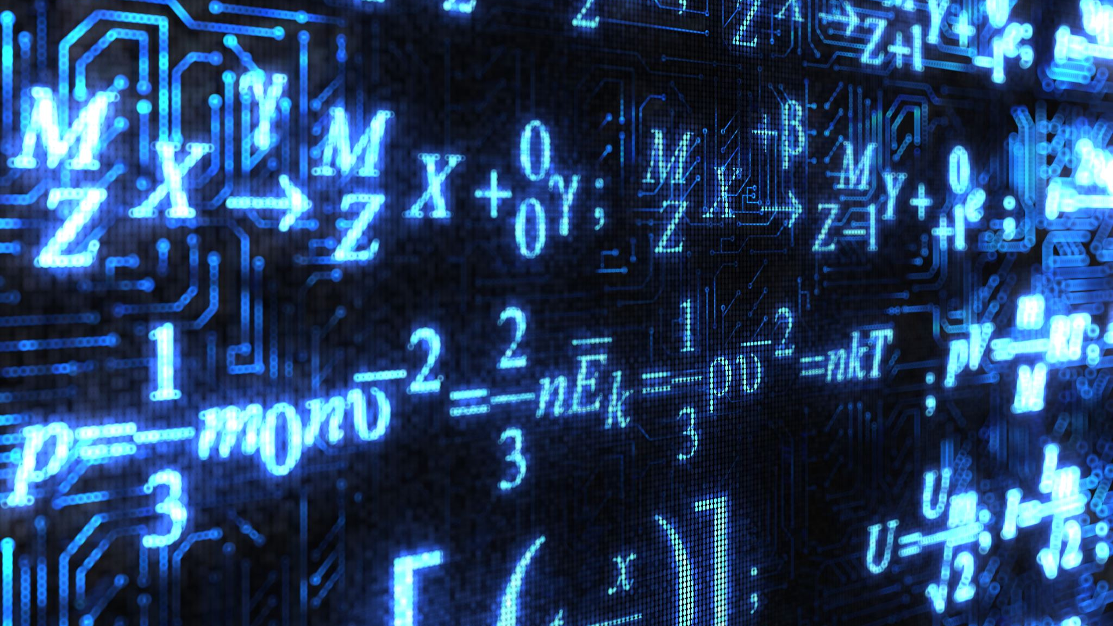
Face Recognition using Deep Learning techniques
By: Mostofa Adib Shakib

Slide 2
Face Recognition Flow
Face Detection. Locate one or more faces in the image and mark with a bounding box.
Face Alignment. Normalize the face to be consistent with the database, such as geometry and photometrics.
Feature Extraction. Extract features from the face that can be used for the recognition task.
Face Recognition. Perform matching of the face against one or more known faces in a prepared database.
Face Recognition Task:
Face Matching: Find the best match for a given face.
Face Similarity: Find faces that are most similar to a given face.
Face Transformation: Generate new faces that are similar to a given face.

Slide 3
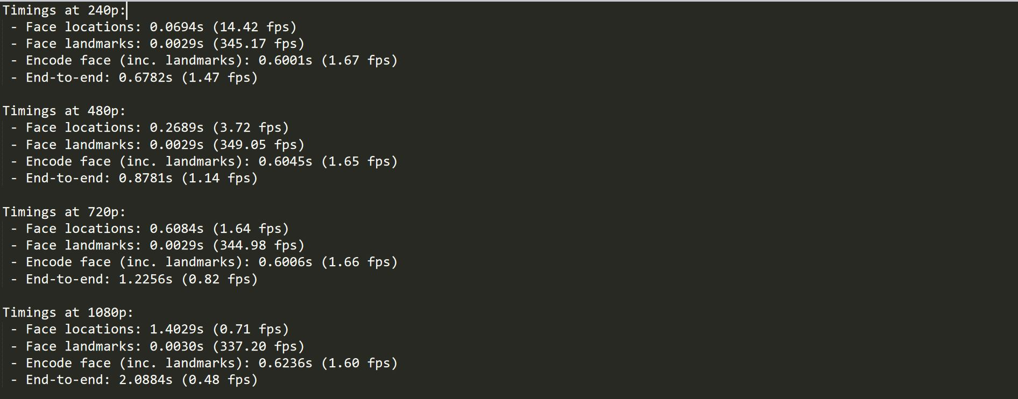
Does face detection depends on the size of the image? From the screenshot below we can clearly see that each step of the face detection process takes longer time to execute as the size of the input image increases.

Slide 4
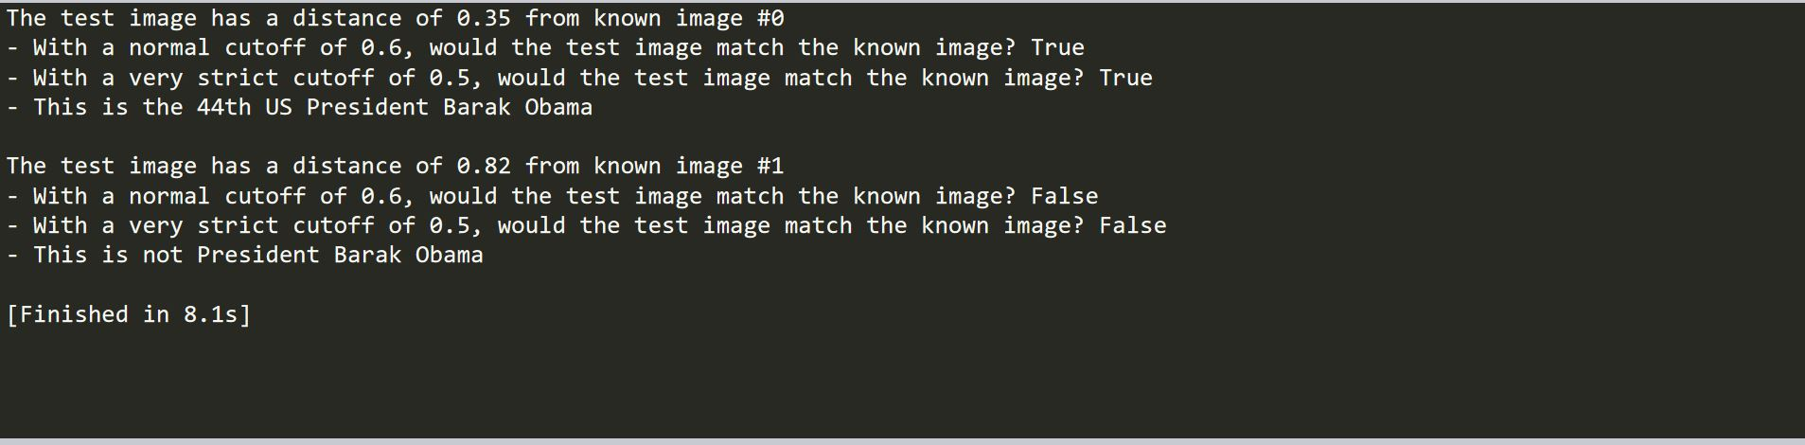
How do we compare image to see if they are a match?
We use the built-in method compare_faces from the face_recognition library to compare a list of know face encoding of against other candidates to see if they match. The tolerance is set to a strict 0.5 so if the face_distance’s value is less than 0.5 only then we say that the two images are a match.

Slide 5
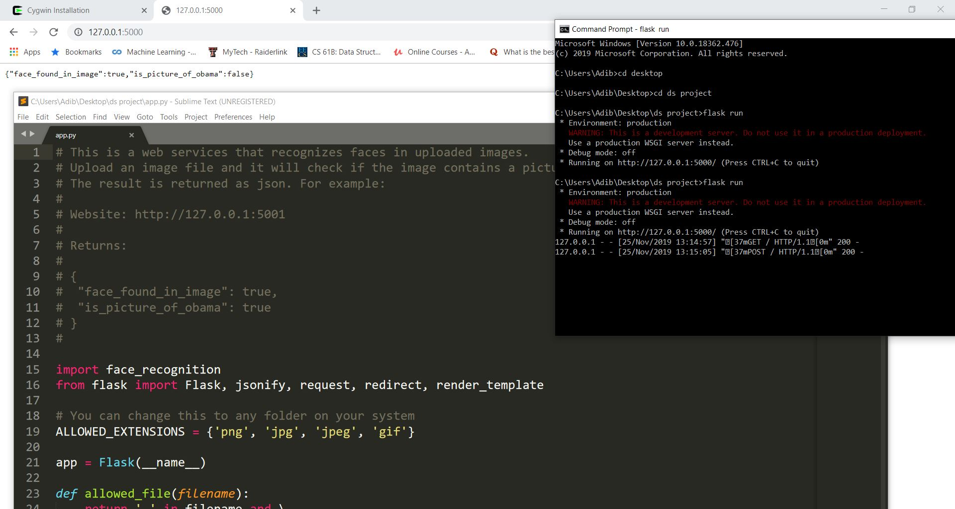
How do we compare image to see if they are a match? (Alternate way)
This method compares to encoding values to check if two images are match or not. The output is a json file.
A website built with Python Flask is hosted locally from where an unknown image is uploaded.

Slide 6
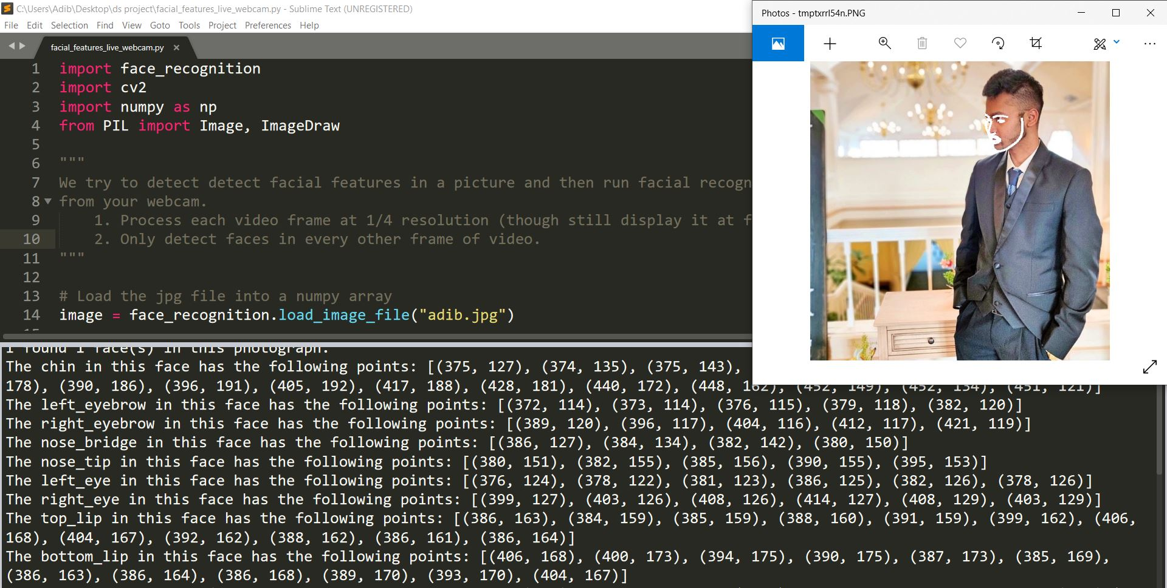
Facial feature extraction

Slide 7
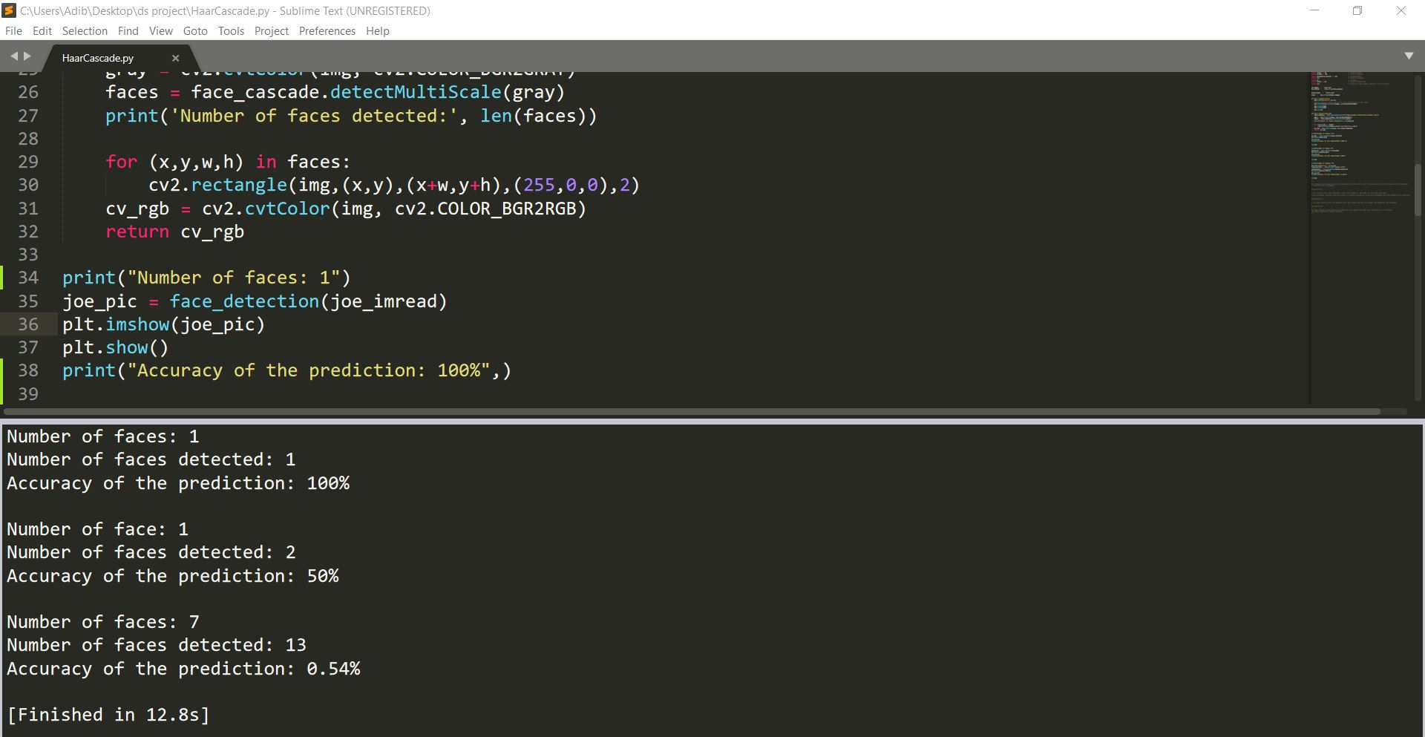
Facial detection using Haar Cascade

Slide 8
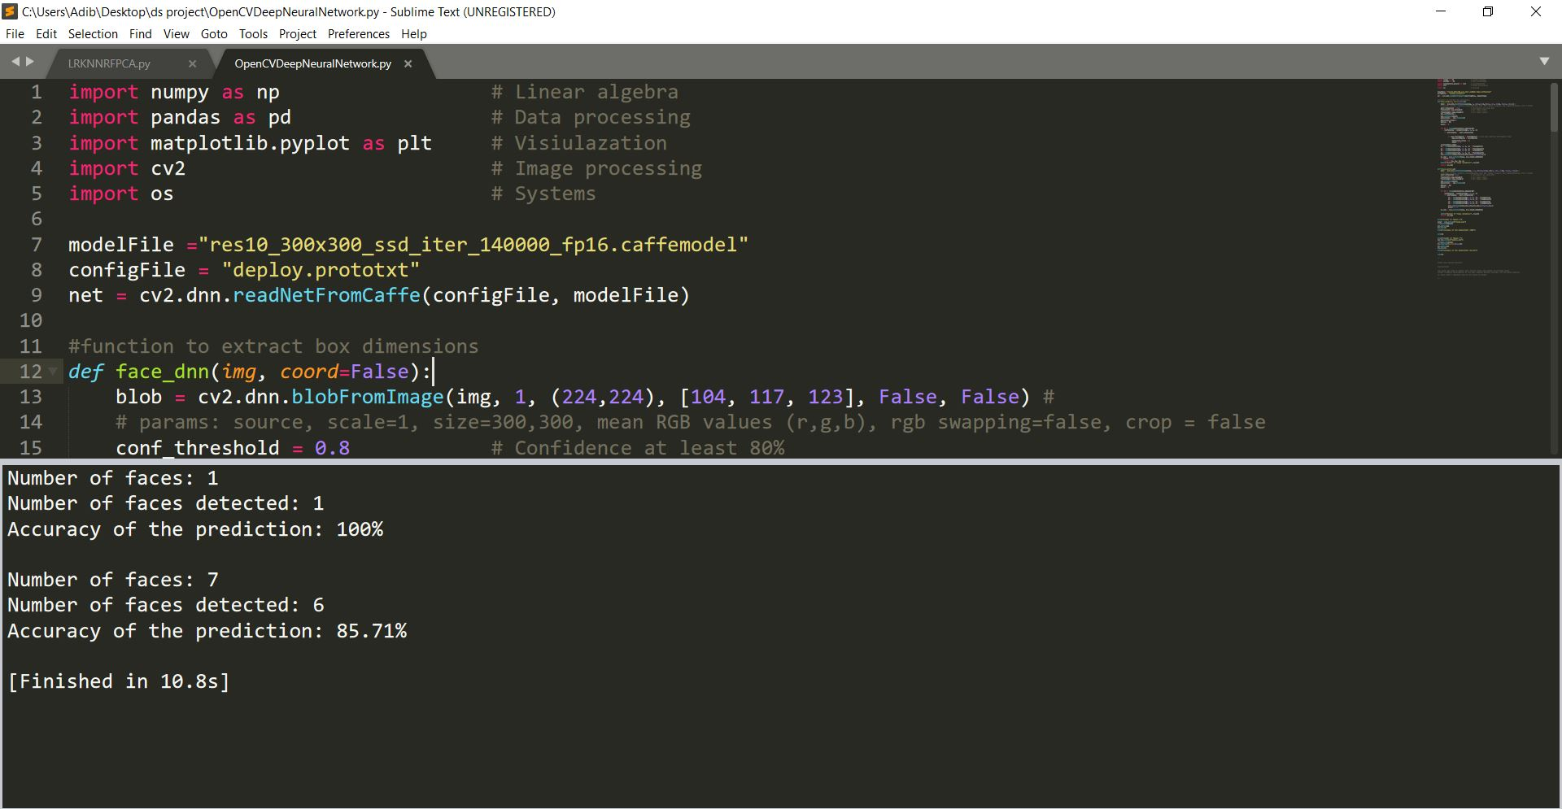
Facial detection using deep neural networks(DNN)

Slide 9
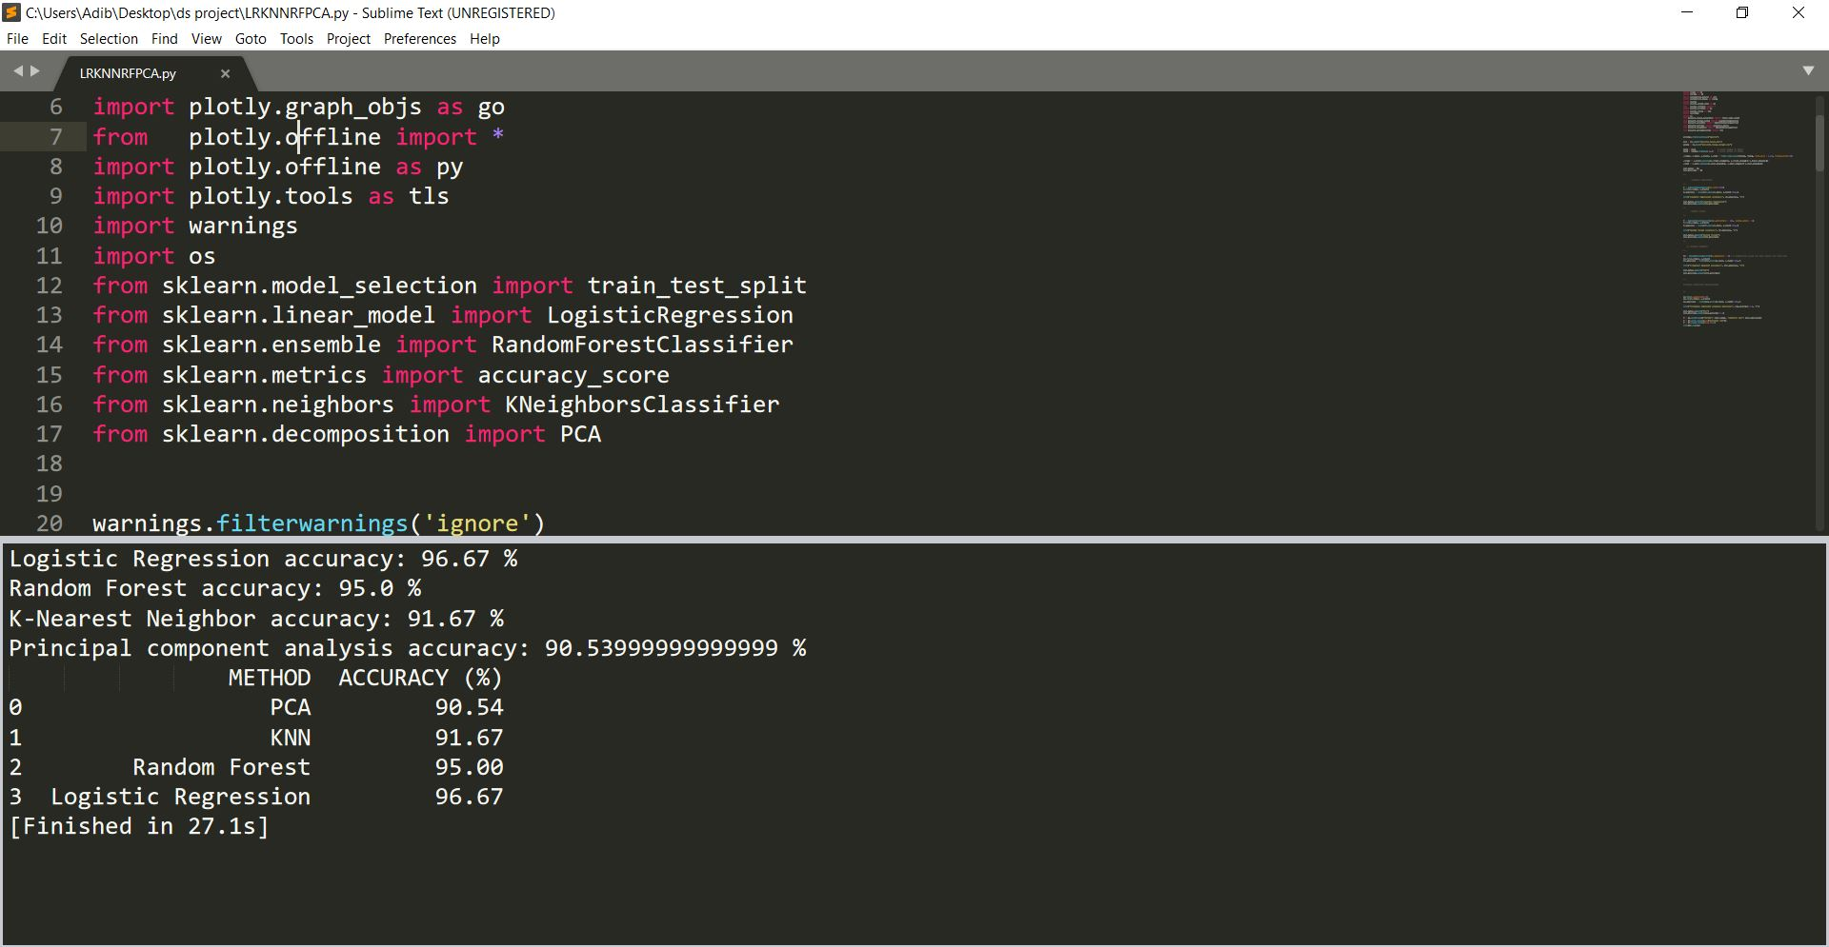
Facial detection using PCA, KNN,RF, LR

Slide 10
Summary of the predictions.
Haar Cascade: Single picture: 50%, Multiple picture: 54%
Deep neural network: Single picture: 100%, Multiple picture: 85.71%
Principal Component Analysis(PCA): 90.54%
K-Nearest Neighbor(KNN): 91.67%
Random Forest(RF): 95%
Logistic Regression: 96.67%
Conclusion: The more sample images of a subject you have the better is the prediction.

Slide 11
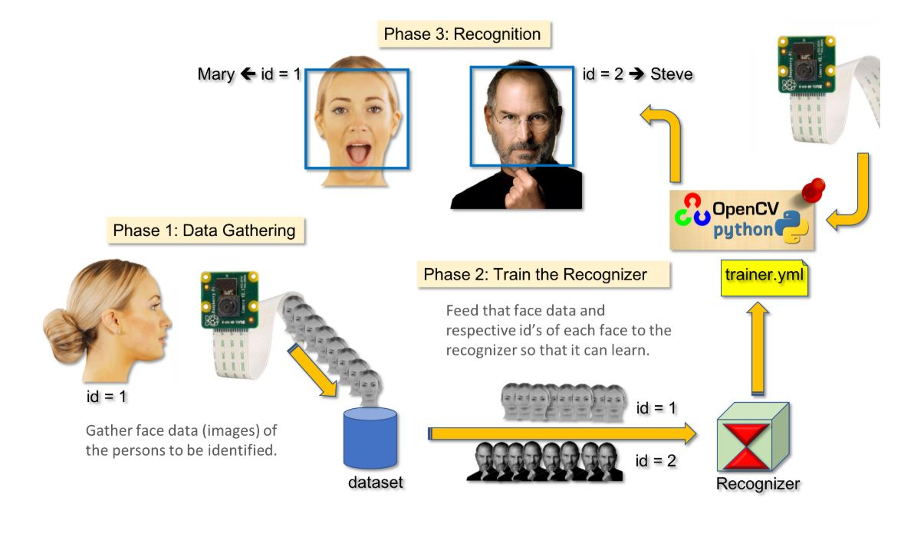
Real-Time Face Recognition using OpenCV

